Slide 1
HELLO!

Slide 2
- S.O.L.I.D - Models for the Rescue - Domain Driven Design - DDD Introduction - DDD Strategic Design - DDD Tactical Design - Software Architecture (Parts I, II & III) - Application Lifecycle Management - Continuous Integration, Deployment, Delivery - Generic Domain as a Service - CQRS - Event Sourcing - oAuth 2.0 & OIDC - Lucene - Hystrix - Cassandra
NOW!
Notes:
Strategic design is macro oriented design.
SOLID applied at system level architecture

Slide 3
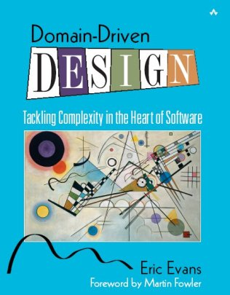
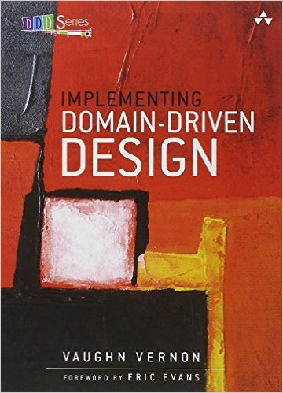
Domain Driven Design Strategic Design
Notes:
- How the Blue book is organized. Read Part IV: Strategic Design to the end and then the whole book.

Slide 4
Domain Driven Design Strategic Design
FOR MANAGERS
https://goo.gl/s5nd4C
Notes:
- How the Blue book is organized. Read Part IV: Strategic Design to the end and then the whole book.

Slide 5
Domain Driven Development
Notes:
iTS NOT Domain Driven Development

Slide 6
Domain Driven Development
Domain Driven Design

Slide 7
Recap
Finding the domain experts is essential
Establish Ubiquitous Language
Be aware of Conway’s Law
Big Ball of Mud
Notes:
The big ball of mud starts with a monolith

Slide 8
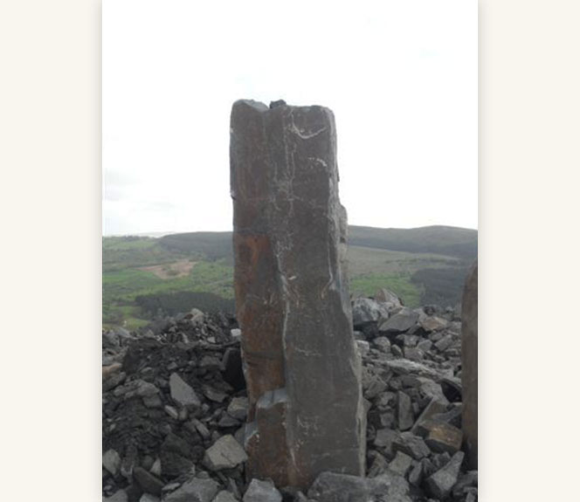
Notes:
Small monolith = no problem
Most of the big systems started this way

Slide 9

Notes:
Big monolith, aka Golqm kamak
Big problem

Slide 10
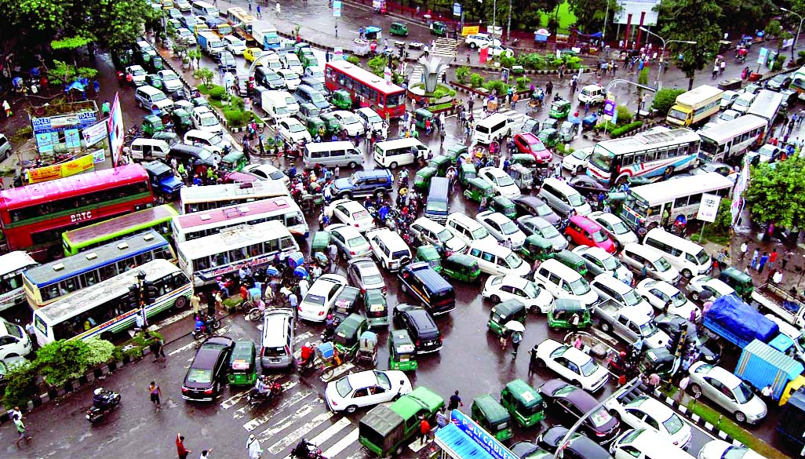

Slide 11
Chaos
None of the system can be well designed

Slide 12
Chaos
None of the system can be well designed
Precision designs are fragile

Slide 13
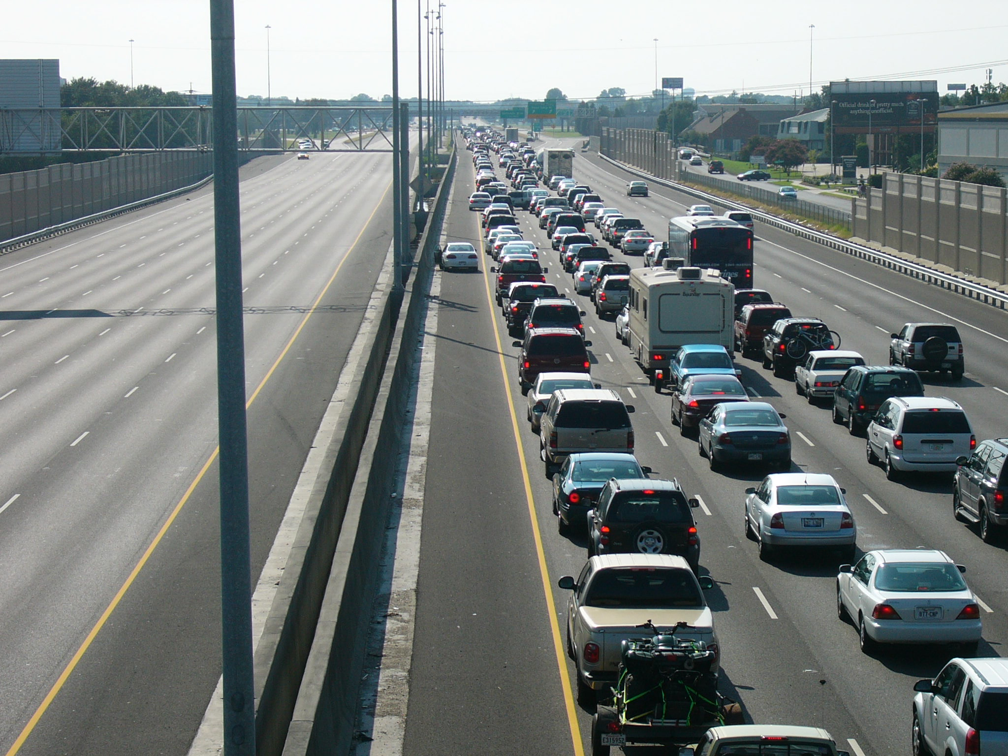
Notes:
- Boundaries achieve some level of organization/order

Slide 14

Notes:
Boundaries are not just brick walls which you cannot cross.
Boundaries can keep you away from mixing responsibilities and in general doing stupid things.

Slide 15
Organized Chaos
Boundaries
Macro vs Micro architecture
Notes:
Boundaries
It is hard to apply changes at macro level (public API)

Slide 16
Sales
Reporting
Shipping
Billing
Orders
Notes:
Visualize the business process flows on high level
Visualize boundaries
Macro architecture
Much harder to introduce changes
Actually changes occur very rarely

Slide 17
Macro - Cross-system
Responsibilities
UI integration
Communication protocols
Data formats
Redundant data
Logging, Monitoring
Notes:
Boundaries
It is hard to apply changes at macro level (public API)

Slide 18
Java
Ruby
C#
Scala
F#
Notes:
Every part of the system can be implemented differently.

Slide 19
MySQL
NoSQL
Cassandra
Something
MSSQL

Slide 20
Micro – System Internal
Programming languages
Development tools
Frameworks
Process/Workflow control
Persistence
Design patterns
Coding guidelines
Notes:
Let the team to take decisions

Slide 21
Where to start?

Slide 22
Problem Space
Domain
Decompose into sub-domains
Or generic sub-domains

Slide 23
Chaos
DOMAIN

Slide 24
Distilling Core Domain
DOMAIN
CORE

Slide 25
Distilling Core Domain
DOMAIN
CORE
Supporting
Subdomain A
Supporting
Subdomain B
Generic
Subdomain

Slide 26
Solution Space
Domain model
Bounded Context

Slide 27
Domain Models
Business Model
Non anemic
Strong encapsulation
Notes:
- One concept can exists in two contexts designed with two different models.

Slide 28
Bounded Context
CORE
Formed from Ubiquitous Language
Defines boundaries
Supporting
Subdomain A
Supporting
Subdomain B
Generic
Subdomain

Slide 29
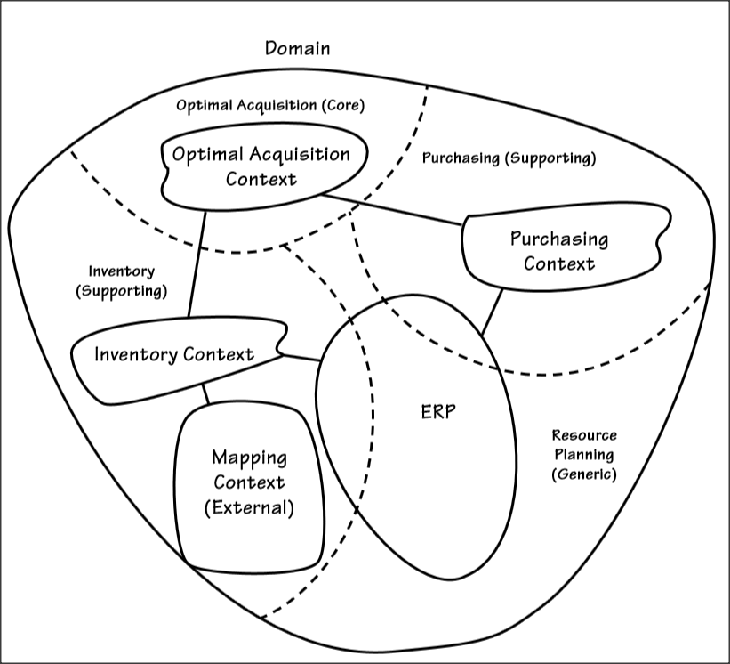
CORE
Supporting
Subdomain A
Supporting
Subdomain B
Generic
Subdomain
Notes:
Bounded Context Example

Slide 30
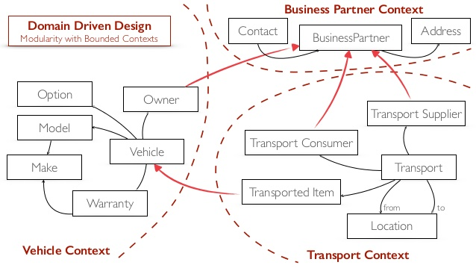
CORE
Supporting
Subdomain A
Supporting
Subdomain B
Generic
Subdomain
Notes:
Bounded Context Example

Slide 31
Context Map
What are the models?
What are boundaries within which they are used?
What are the relationships between the models?
Notes:
- One concept can exists in two contexts designed with two different models.

Slide 32
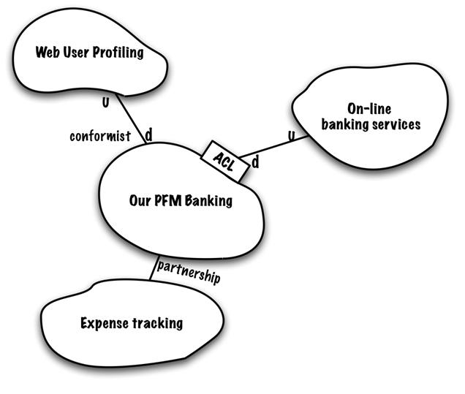
Notes:
- One concept can exists in two contexts designed with two different models.

Slide 33
RECAP
Establish UL
Define Boundaries
Create Bounded Contexts
Draw Context Maps
Notes:
- One concept can exists in two contexts designed with two different models.

Slide 34
Credits
Domain-Driven Design: Tackling Complexity in the Heart of Software
Domain-Driven Design Quickly
Implementing Domain-Driven Design
https://domainlanguage.com/ddd/howtoreadthebook/ReadingDDDForManagers.pdf

Slide 35
- S.O.L.I.D - Models for the Rescue - Domain Driven Design - DDD Introduction - DDD Strategic Design - DDD Tactical Design - Software Architecture (Parts I, II & III) - Application Lifecycle Management - Continuous Integration, Deployment, Delivery - Generic Domain as a Service - CQRS - Event Sourcing - oAuth 2.0 & OIDC - Lucene - Hystrix - Cassandra
Coming up!
Notes:
Software Architecture
Boundaries,
CAP Theorem
Layered Architecture
Messaging
Microservices
Onion Architecture
Scalability
SOA
Logical Architecture vs Physical Architecture
Publish/Subscribe
Eventual Consistency

Slide 36
THANKS!
Any questions?

